Slide 1

ARIZONA ENVIRONMENTAL STRATEGIC ALLIANCE Welcome to Intel
Craig McCurry, P.E.
Senior Environmental Engineer

Slide 2
The Arizona Environmental Strategic Alliance is a unique government and industry partnership founded in environmental leadership, integrity, and social responsibility. As leaders, Alliance members believe that environmental responsibility and leadership are both the cornerstone and integral to good business management. To this end, our members strive to preserve the delicate balance between environmental and economic sustainability.
The Alliance will protect and conserve Arizona’s environment, encourage innovative environmental actions through leadership, mentoring, and sustainability practices, and showcase the economic benefit of going beyond compliance.
Stack Testing Conference Sponsors

Slide 3
Stack Testing AGENDA

Slide 4
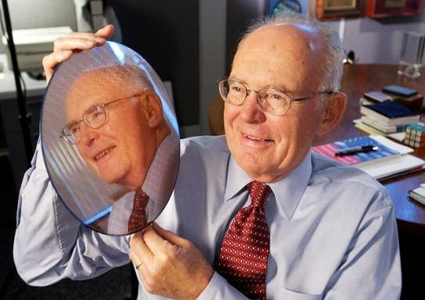
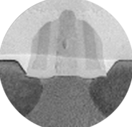
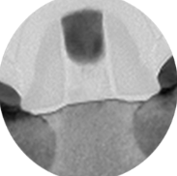
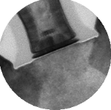
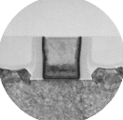
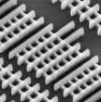

Executing to Moore’s Law
“We need to continually improve our manufacturing process, thereby reducing our burden on the environment and becoming an asset to the communities in which we live and work.”
Gordon Moore, Intel Chairman
Letter in EHS Report
January 1995
Enabling new devices with higher
functionality and complexity while
controlling power, cost, and size
Strained Silicon
Hi-K Metal Gate
3D Transistors
90 nm
65 nm
45 nm
32 nm
22 nm
14 nm
10 nm
7 nm
Notes:
As Gordon Moore predicted in 1965, increasing complexity of integrated circuits will result in a reduction in cost of transistors – the fundamental building block of the digital age – at a steady, exponential rate. This decrease in cost as well as transistor size has also led to dramatic increases in compute power and energy efficiency and transformed our world with ever-more powerful smart phones, tablets, personal computers and data centers. But Moore’s Law is not a scientific principle. Rather, it’s an observation of the pace at which the industry is able to deliver more computing functionality at ever lower cost. And almost from the very moment of Moore’s Law being posed and becoming understood, there has been speculation that it will someday end. Yet each time, Intel engineers have found a way to innovate, go past, around, and through perceived obstacles, using new materials and inventing new technologies along the way.

Slide 5
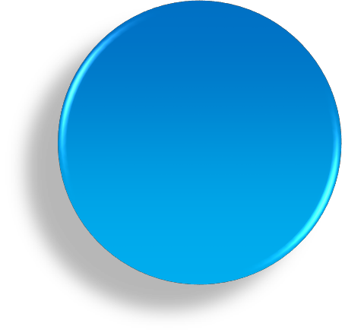
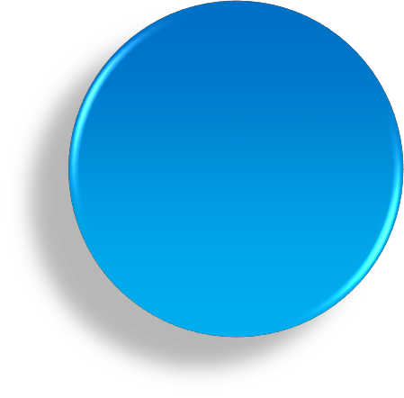
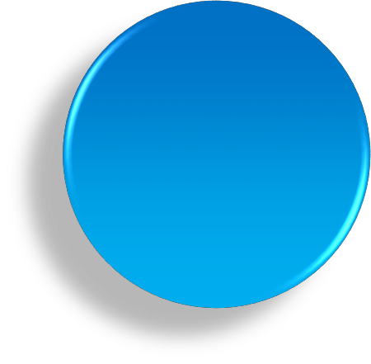

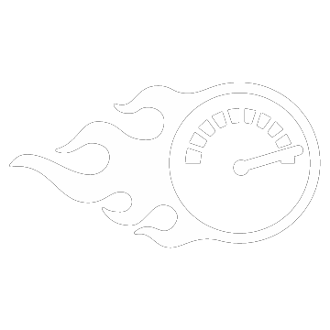












7th Gen Intel® Core™ processors
Performance Leadership
Work, multitask, create
1.7X – 15X¹ faster
Bringing 4K Uhd mainstream
“All Day 4K” battery life
(9.5hr)²
Premium 4K UHD content on your PC
Feature rich
Innovative designs
New levels of thin 2 in 1s
and clamshells
120+ Thunderbolt™ 3 100+ Windows® Hello 4K 50+ 4K UHD
25+ Pen designs
>100 designs in Q4’16 starting in September
Software and workloads used in performance tests may have been optimized for performance only on Intel microprocessors. Performance tests, such as SYSmark and MobileMark, are measured using specific computer systems, components, software, operations and functions. Any change to any of those factors may cause the results to vary. You should consult other
¹Range of performance scores on benchmarks in this presentation
information and performance tests to assist you in fully evaluating your contemplated purchases, including the performance of that product when combined with other products. For more complete information about performance and benchmark results, visit http://www.intel.com/benchmarks
² Based on 4K HEVC 10-bit local video playback on Intel® Core™ i7-7500U at 66WHr battery and 4K panel See appendix for configurations

Slide 6
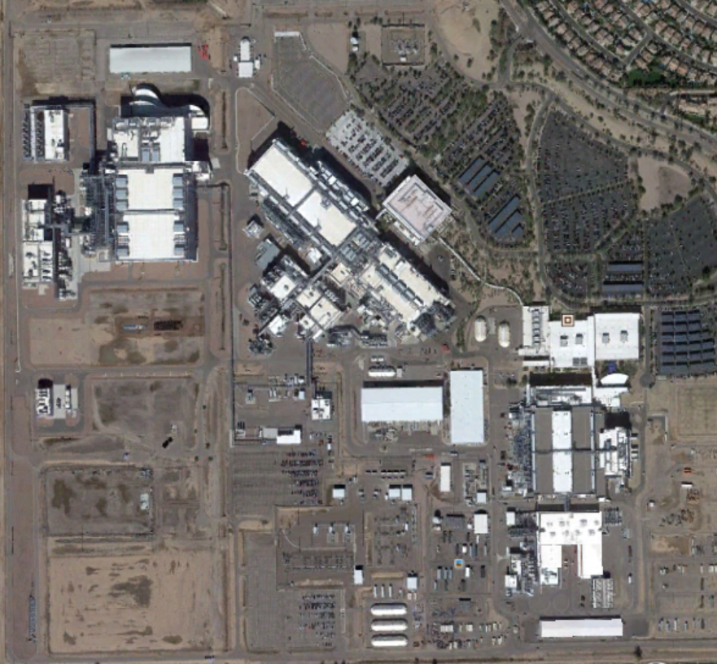
Intel Arizona
One of the largest and most complex semiconductor manufacturing sites in the world
Capital investment of $20 billion in manufacturing at the Ocotillo site since 1996 (Intel established AZ operations in 1979)
$5.3 billion annual economic impact to Arizona
Currently 11,000 employees – Fab 42 +3,000
Intel was ranked No.1 by the Phoenix Business Journal for total LEED-certified space in Arizona
Since 1996, more than 5.1 billion gallons of water have been returned to the aquifer by Intel, enough to support almost 35,000 households for a family of four per year
In 2015, Intel Arizona had a non-hazardous solid waste recycling rate of 87%

Slide 7
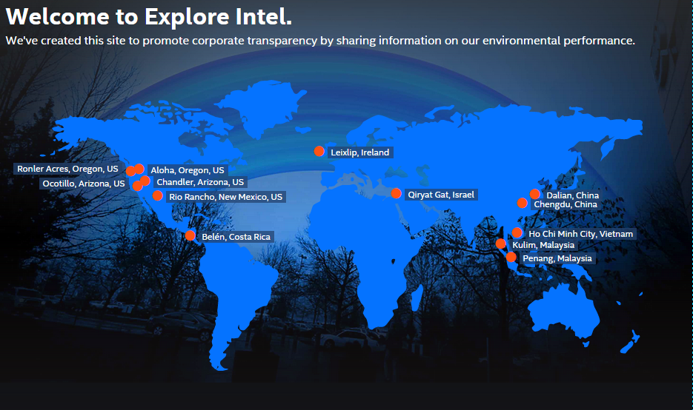
Exploreintel.com – Openly sharing our environmental performance

Slide 8
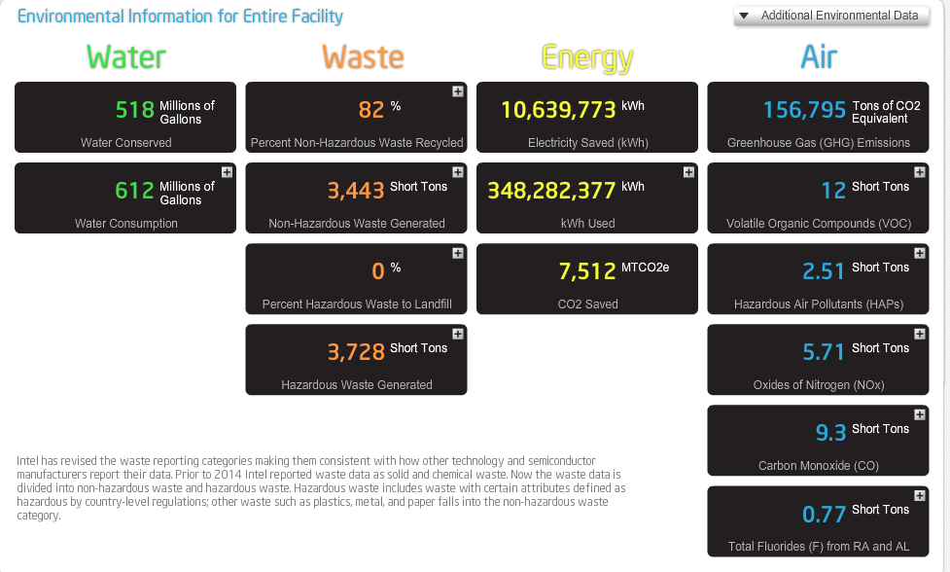
Transparency leadership
Exploreintel.com – Openly sharing our environmental performance

Slide 9
Current Stack Test Requirements
Acid Scrubbers

Slide 10
Current Stack Test Requirements
RCTO UNITS

Slide 11
Current Stack Test Requirements
Boilers and Waste Treatment Units

